Slide 1
EPILEPSY & ANTI-EPILEPTIC DRUGS
R. MAITI, SENIOR LECTURER IN PHARMACY

Slide 2
EPILEPSY
Convulsion:
Sudden attack of involuntary muscular contractions and relaxations.
Seizure:
The clinical manifestation of an abnormal hyper-synchronized impulse discharge in a population of cortical excitatory neurons
Epilepsy:
A tendency toward recurrent seizures unprovoked by acute systemic or neurologic insults

Slide 3
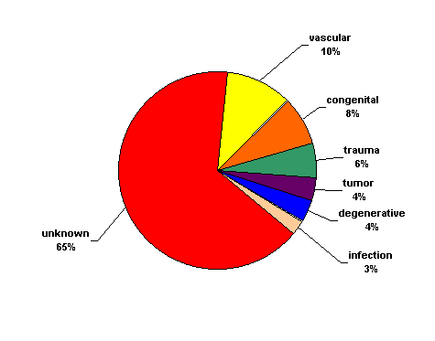
EPILEPSY
Causes:
Genetic (autosomal dominant genes)
Congenital defects
Severe head trauma
Ischemic injury, tumor
Drug abuse
Unknown

Slide 4
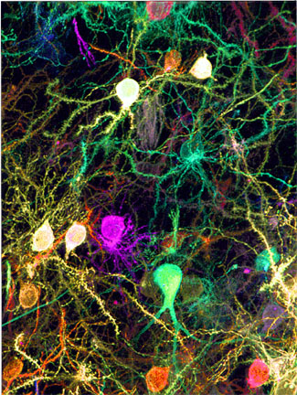
The Brain
An extremely complex organ made up of billions of connections between neurons.
These connections are each highly controlled and regulated.

Slide 5
EPILEPSY
Neurons communicate between themselves using small molecules called neurotransmitters.
These neurotransmitters modulate and regulate the electrical activity of a given neuron, and tell it when to fire an action potential or when not to.
Glutamate = excitatory (tells the neuron to fire)
GABA = inhibitory (dampens the neuron firing rate)
The action potential is an electrical signal that travels down the axon, and is created using sodium ions (Na+), and inhibited by potassium ions (K+).
Usually these processes work synergistically to produce normal behavior and activity.
When dysfunctional, abnormal electrical activity occurs and can produce seizures.

Slide 6
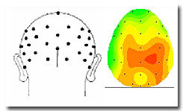
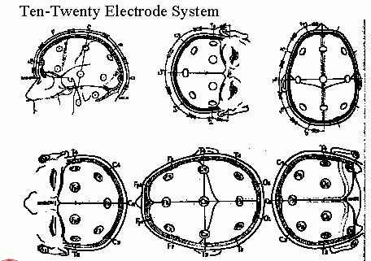
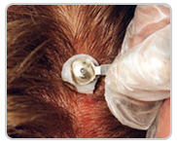
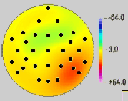
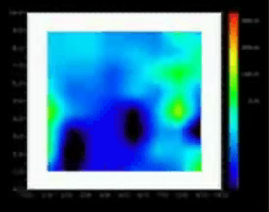
Scalp EEG Data Acquisition

Slide 7
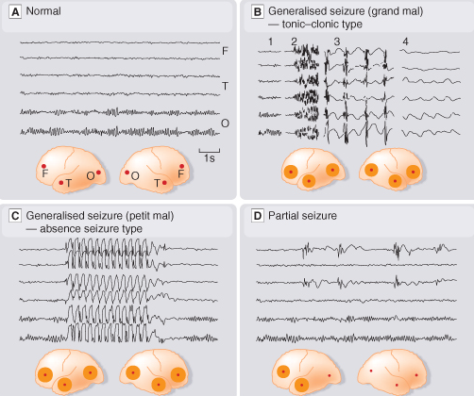
EEG
Cortex:
F – frontal
O – occipital
T – temporal
Rang et al.
Pharmacology
– 5th Ed. (2003)
Classification of seizures

Slide 8
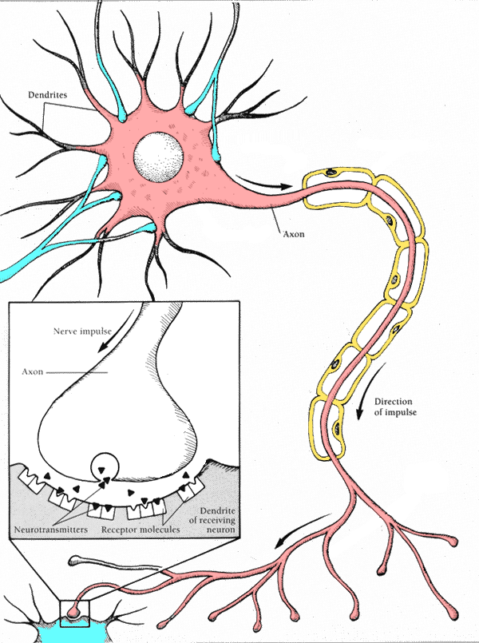
Sodium Ions/Channels
Potassium Ions/Channels
Action Potential
Neurotransmitters
(Glutamate, GABA)

Slide 9
EPILEPSY- TYPES OF SEIZURES
Generalized Seizures - Excessive electrical activity in both cerebral hemispheres.
Usually originates in the thalamus or brainstem.
Affects the whole body.
Loss of consciousness is common.

Slide 10
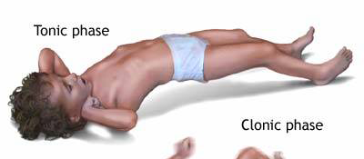

Generalized Seizures
Myoclonic: Brief shock-like muscle jerks generalized or restricted to part of one extremity.
Atonic: Sudden loss of muscle tone.
Tonic Seizures: sudden stiffening of the body, arms, or legs
Clonic Seizures: rhythmic jerking movements of the arms and legs without a tonic component
Tonic-clonic (grand mal):
Tonic phase followed by clonic phase
http://www.nlm.nih.gov/medlineplus/ency/images/ency/fullsize/19076.jpg

Slide 11
Generalized Seizures
Absence (petit mal): Person appears to “blank out” - “Daydreaming”
Simple Absence (primarily effects consciousness only)
Complex Absence
Atypical Absence (Includes physical symptoms like eye blinking or lip movements)
Lenox-Glastaut Syndrome.
Atypical absence, atonic and myclonic
Status Epilepticus: A seizure lasting longer than 30 min, or 3 seizures without a normal period in between
May be fatal
Emergency intervention required

Slide 12
Partial (focal) Seizures
Excessive electrical activity in one cerebral hemisphere. -Affects only part of the body.
Simple Partial: Person may experience a range of strange or unusual sensations.
Motor
Sensory
Autonomic
Key feature: preservation of consciousness.
Complex Partial:
Loss of awareness at seizure onset. Person seems dazed or confused and exhibits meaningless behaviors.
Typically originate in frontal or temporal lobes (e.g. Temporal lobe epilepsy)

Slide 13
Seizure Facts
Seizures are not usually life threatening.
The brain almost always stops the seizure on its own.
Breathing may cease for a few seconds, and the patient may turn blue.
People don’t feel pain during a seizure; muscles may be sore afterward.
Person may be “different” for a while after the seizure.

Slide 14
Treatment ASPECT
Try to find a cause. (e.g. fever, head trauma, drug abuse)
Recurrent seizures that cannot be attributed to any cause are seen in patients with epilepsy.
Therapy is aimed at control
drugs do not cure.
The type of seizure determines the choice of drug!
More than 80% of patients with epilepsy can have their seizures controlled with medications.

Slide 15
Treatment ASPECT
Monotherapy with anticonvulsant
Increase dose gradually until seizures are controlled or adverse effects become unacceptable.
Multiple-drug therapy may be required.
Achieve steady-state kinetics
Monitor plasma drug levels
Avoid sudden withdrawal

Slide 16
1. Carboxamides (enzyme inductors – CYP450):
Carbamazepine (+ neuropathic pain – n. trigeminus,
postherpetic pain, etc.), Oxcarbazepine
2. Hydantoins: Phenytoin (enzyme inductor), used in digitalis
intoxication too
3. Barbiturates (Phenobarbital – enzyme inductors) and their
analogues (Primidone – prodrug)
4. Succinimides: Ethosuximide (casp. 250 mg – petit mal)
5. Valproates (enzyme inhibitors): Sodium valproate (Depakin®)
6. Benzodiazepines: Clonazepam, Clorazepate, Diazepam
t_{1/2} 43 h, amp. 10 mg/2 ml i.m./i.v., Lorazepam, Nitrazepam
7. GABA analogues: Gabapentin, Tiagabine
8. Hetereogenic anticonvulsants: Lamotrigine, Levetiracetam,
Pregabalin (partial seizures, peripheral neuropathic pain),
Topiramate, Vigabatrin
ANTISEIZURE DRUGS

Slide 17
MOA OF ANTIEPILEPTIC DRUGS
Antiepileptics inhibit the neuronal discharge or its spread in one or
more of the following ways:
(1) Enhancing GABA synaptic transmission: barbiturates, benzo-
diazepines, gabapentin, levetiracetam, tiagabine, vigabatrin, topira-
mate, valproate; the result is increased permeability to chloride ion,
which reduces neuronal excitability. Valproate and topiramate block
GABA transaminase and tiagabine blocks reuptake of GABA.
(2) Reducing cell membrane permeability to voltage-dependent
sodium channels: carbamazepine, lamotrigine, oxcarbazepine,
phenytoin, topiramate, valproate.
(3) Reducing cell membrane permeability to calcium T-channels:
valproate, ethosuximide; the result is diminishing of the generation
of action potential.
(4) Inhibiting excitory neurotransmitter glutamate: lamotrigine.

Slide 18
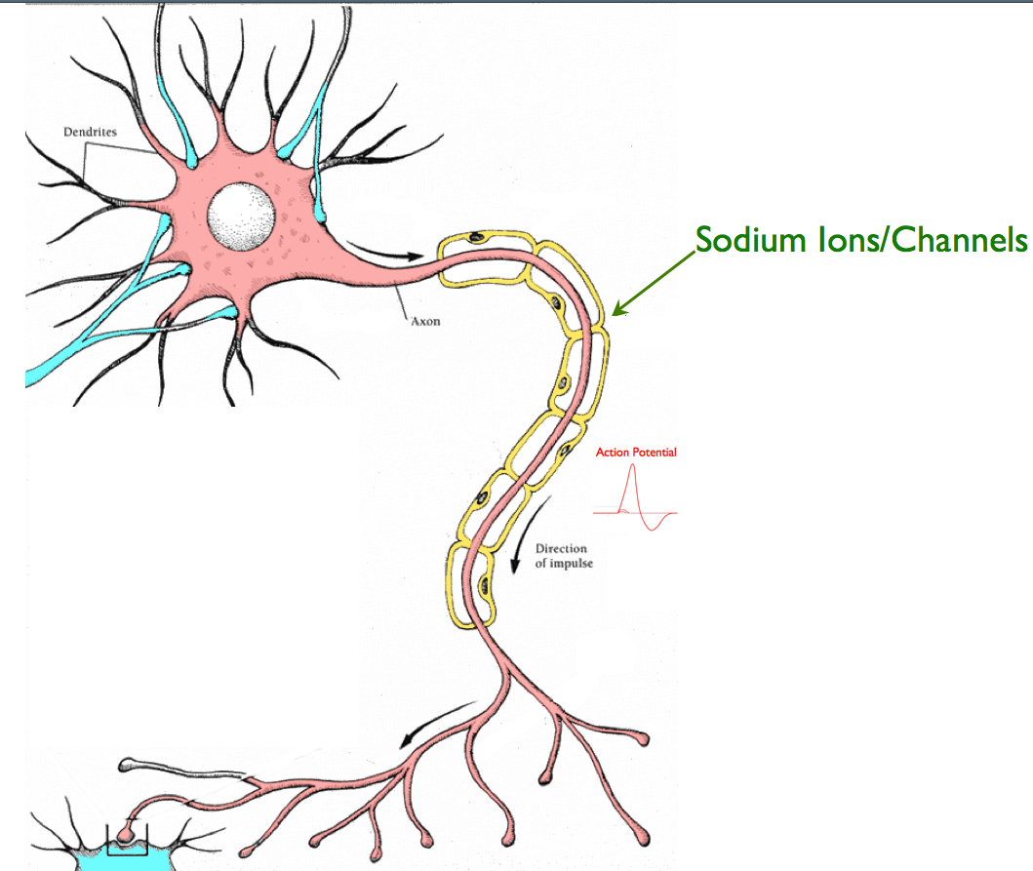
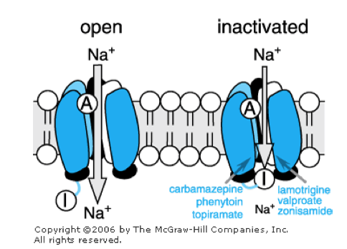
Na+ Channel Inhibitors

Slide 19
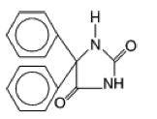
Na+ Channel Inhibitors
Phenytoin :
Indications:
First choice for partial and generalized tonic-clonic seizures
Some efficacy in clonic, myoclonic, atonic,
No effect on infantile spasms or absence seizures
Drug Interactions:
Decreases blood levels of many medications
Increases blood levels of phenobarbital & warfarin

Slide 20
Na+ Channel Inhibitors
Phenytoin :
Adverse Effects:
Hirsutism & coarsening of facial features
Acne
Gingival hyperplasia (20-40%)
Brush teeth >8 times per day
A primary reason not to prescribe for children
Decreased serum concentrations of folic acid, thyroxine, and vitamin K with long-term use.

Slide 21
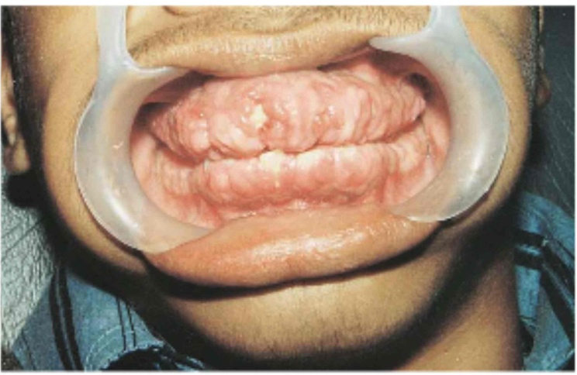
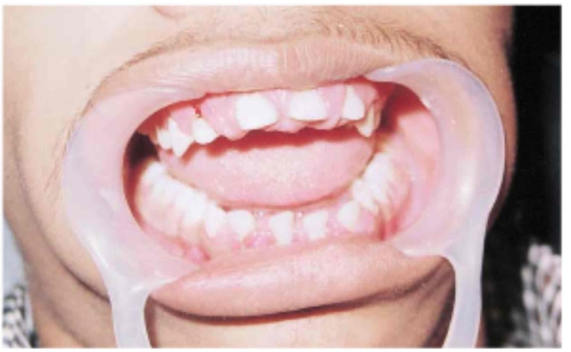
Phenytoin Induced Gingival Hyperplasia
17 year old boy treated with 300mg/day phenytoin for 2 years (unsupervised)
Partial recovery at 3 months after discontinuation
Images in Clinical Medicine (Feb 2000) 342:325

Slide 22
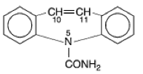
Na+ Channel Inhibitors
Carbamazepine :
Indications:
First choice for complex partial and generalized tonic-clonic seizures.
Contraindications:
May exacerbate absence or myoclonic seizures.
Blood disorders
Liver disorders

Slide 23
Na+ Channel Inhibitors
Carbamazepine :
Drug Interactions:
CBZ metabolism is affected by many drugs, and CBZ affects the metabolism of many drugs.
Adverse Effects:
Mild leukopenia or hyponatremia
Circulating concentrations of thyroid hormones may be depressed; TSH remains normal.

Slide 24
Na+ Channel Inhibitors
Oxcarbazepine :
FDA approved in 2000 for partial seizures
Complex partial seizures
Primary & secondarily generalized tonic-clonic seizures
No effect on absence or myoclonic seizures
Fewer adverse effects than CBZ, phenytoin

Slide 25
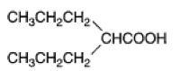
Na+ Channel Inhibitors
Valproic Acid :
Mechanisms of Action:
1) Some inhibition of T-type Ca2+ channels.
2) Increases GABA production and decreases GABA metabolism.
Indications:
Simple or complex partial, & primary generalized tonic-clonic
Also used for absence, myoclonic, and atonic seizures.
Highly effective for photosensitive epilepsy and juvenile myoclonic epilepsy.
Contraindications:
Liver disease

Slide 26
Na+ Channel Inhibitors
Valproic Acid :
Drug Interactions:
Affects metabolism of many drugs through liver enzyme inhibition
Phenobarbital
“Drunkenness”
Clorazepam
Prolonged absence seizures

Slide 27
Na+ Channel Inhibitors
Valproic Acid :
Adverse Effects:
Weight gain (30-50%)
Dose-related tremor
Transient hair loss
Polycystic ovary syndrome and menstrual disturbances
Bone loss
Ankle swelling

Slide 28
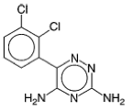
Na+ Channel Inhibitors
Lamotrigine :
Mechanism of Action:
May inhibit synaptic release of glutamate.
Indications:
Adjunct therapy (ages 2 & up):
Simple & complex partial seizures
Generalized seizures of Lennox-Gastaut Syndrome
Monotherapy (adults):
Simple & complex partial seizures
Contraindications:
May make myoclonic seizures worse.

Slide 29
Na+ Channel Inhibitors
Lamotrigine :
Adverse Effects:
Rash (10%)
Rare progression to serious systemic illness
Increased alertness

Slide 30
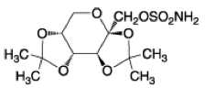
Na+ Channel Inhibitors
Topiramate :
Mechanism of Action:
Enhances post-synaptic GABAA receptor currents.
Kainate receptor antagonist (blocks a certain type of glutamate channel)
Indications:
Adjunct therapy for partial and primary generalized tonic-clonic seizures in adults and children over 2.
Decreases tonic and atonic seizures in children with Lennox-Gastaut syndrome.
Contraindications:
History of kidney stones

Slide 31
Na+ Channel Inhibitors
Topiramate :
Drug Interactions:
CBZ, phenytoin, phenobarbital, & primidone decrease blood levels
Adverse Effects:
Nervousness & paresthesias
Psychomotor slowing, word-finding difficulty, impaired concentration, interference with memory
Weight loss & anorexia
Metabolic acidosis

Slide 32
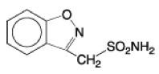
Na+ Channel Inhibitors
Zonisamide :
Mechanism of Action:
Inhibits T-type Ca2+ currents.
Binds to GABA receptors.
Facilitates dopaminergic and serotonergic neurotransmission.

Slide 33
Na+ Channel Inhibitors
Zonisamide :
Indications:
Approved for adjunct treatment of partial seizures in adults.
Appears to have a broad spectrum:
Myoclonic seizures
Infantile spasms
Generalized & atypical absence seizures
Lennox-Gastaut Syndrome
Drug Interactions:
Phenytoin and carbamazepine decrease its half-life by half.

Slide 34
Na+ Channel Inhibitors
Zomisamide :
Adverse Effects:
Weight loss
Abnormal thinking
Nervousness
Agitation/irritability
Usually well tolerated

Slide 35
Na+ Channel Inhibitors
Lidocaine: Only when other drugs are refractory for status epilepticus.

Slide 36
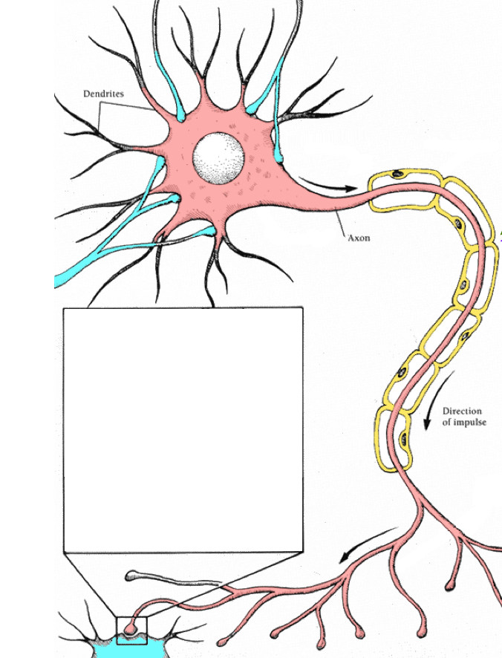
Enhancement of GABA Inhibition

Slide 37
Enhancement of GABA Inhibition
Barbiturate drugs:
Phenobarbital & Primidone:
Mechanism of Action:
Increases the duration of GABAA-activated Cl- channel opening.

Slide 38
Enhancement of GABA Inhibition
Phenobarbital:
Indications:
Second choice for partial and generalized tonic-clonic seizures.
Rapid absorption has made it a common choice for seizures in infants, but adverse cognitive effects cause it to be used less in older children and adults.
Status epilepticus
Contraindications:
Absence Seizures

Slide 39
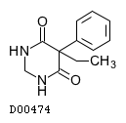
Enhancement of GABA Inhibition
Primidone:
Indications:
Adjuvant or monotherapy for partial and generalized tonic-clonic seizures
May control refractory generalized tonic-clonic seizures
Contraindications:
History of porphyria

Slide 40
Enhancement of GABA Inhibition
Phenobarbital & Primidone:
Drug Interactions:
Other CNS depressants
Increased metabolism of vitamin D and K
Phenytoin increases the conversion of primidone to phenobarbital.
Adverse Effects:
Agitation and confusion in the elderly.
Worsening of pre-existing hyperactivity and aggressiveness in children
Sexual side effects
Physical dependence

Slide 41
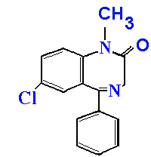
Enhancement of GABA Inhibition
Benzodiazepine drugs:
Diazepam (Valium), lorazepam (Ativan), clonazepam (Klonopin), clorazepate (Transxene-SD)
Mechanism of Action:
Increases the frequency of GABAA-activated Cl- channel opening.

Slide 42
Enhancement of GABA Inhibition
Benzodiazepine drugs:
Indications:
Only clonazepam & clorazepate approved for long-term treatment.
Clorazepate
In combination for partial seizures
Clonazepam
Lennox-Gastaut Syndrome, myoclonic, atonic, and absence seizures
Tolerance develops after about 6 months

Slide 43
Enhancement of GABA Inhibition
Benzodiazepine drugs:
Indications:
Diazepam and lorazepam are used in treatment of status epileticus.
Diazepam is painful to inject; lorazepam is more commonly used in acute treatment.
Diazepam
Intermittent use for control of seizure clusters
Diazepam frequently combined with phenytoin.

Slide 44
Enhancement of GABA Inhibition
Benzodiazepine drugs:
Contraindications:
Diazepam in children under 9
Narrow angle glaucoma
Adverse Effects:
Hypotonia, Dysarthria
Muscle in-coordination (clonazepam)
Behavioral disturbances (especially in children)
Aggression, Hyperactivity, Irritability and Difficulty concentrating

Slide 45
Enhancement of GABA Inhibition
Tiagabine:
Mechanism of Action:
Inhibition of GABA transporter (GAT-1) – reduces reuptake of GABA by neurons and glial cells.
Indications:
Approved in 1998 as an adjunct therapy for partial seizures in patients at least 12 years old.
Contraindications:
Absence seizures

Slide 46
Enhancement of GABA Inhibition
Tiagabine:
Interactions:
Blood levels decreased by CBZ, phenytoin, phenobarbital, & primidone
Adverse Effects:
Asthenia
Abdominal pain

Slide 47
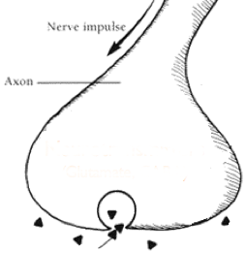
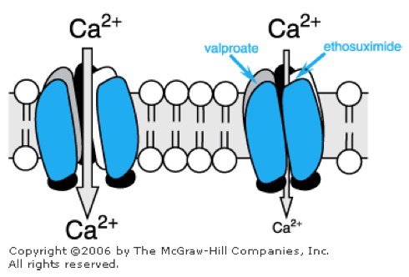
Calcium Channel Blockers

Slide 48
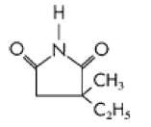
Voltage-Gated Ca2+ Channel T Currents
Ethosuximide:
Mechanism of Action:
Reduces low threshold Ca2+currents (T currents) in the thalamic neurons.
Half-life is ~60 hr in adults; ~30hr in children.
Indications:
First line for absence seizures
Contraindications:
May exacerbate partial & tonic-clonic seizures

Slide 49
Voltage-Gated Ca2+ Channel T Currents
Ethosuximide:
Adverse Effects:
Psychotic behavior
Blood dyscrasias
Persistent headaches
Anorexia
Hiccups
Lupus-like syndromes
Toxicity:
parkinson-like symptoms
photophobia

Slide 50
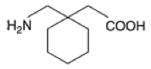
Blockade of Calcium Channels (α2−δ)
Gabapentin:
Mechanism of Action:
Originally designed to be a centrally acting GABA agonist.
Selective inhibition of v-g Ca2+ channels containing the α2δ1 subunit.
Indications:
adjunct therapy in adults and children with partial & secondarily generalized seizures.
Also effective as monotherapy.

Slide 51
Blockade of Calcium Channels (α2−δ)
Gabapentin (Neurontin):
Contraindications:
Can exacerbate myoclonic & absence seizures.
Adverse Effects:
Weight Gain (5%) with ankle edema
Irritability
Behavioral problems in children (6%)
Has been associated with movement disorders.

Slide 52
Blockade of Calcium Channels (α2−δ)
Pregabalin:
Mechanism of Action:
Same as gabapentin
Indications:
Approved in 2005
Adjunct therapy for partial & secondarily generalized seizures
Contraindications:
No effect on absence, myoclonic, or primary generalized tonic-clonic seizures
Other uses:
Prescribed for neuropathic pain, fibromyalgia

Slide 53
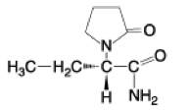
Other/Unknown MOA
Levetiracetam (Keppra):
Mechanism of Action:
Not exactly known
Binding affinity to Synaptic Vesicle Protein 2A correlates with its anticonvulsant activity.
Also blocks calcium channel N-currents, increases intracellular Ca²⁺ levels, modulates GABA channel currents
Indications:
Approved in 1999 as an adjunct therapy for adults with partial seizures.
Some patients have success with monotherapy

Slide 54
Other/Unknown MOA
Levetiracetam (Keppra):
Contraindications:
Renal dysfunction
Adverse Effects:
Asthenia
Infection
Behavioral problems in children

Slide 55
Other/Unknown MOA
Magnesium chloride: Used for magnesium deficiency seizures.
Paraldehyde: Alcohol withdrawal seizures.

Slide 56
Summary
ANTI-EPILEPTICS
Na+ Channel Drugs
Phenytoin
Cabamazepine
Valproic Acid
Lamotrigine
Topiramate
Zonisamide
Lidocaine
GABA Drugs
Barbiturates:
Phenobarbital (Luminal)
Pimidone (Mysoline)
Benzodiazepines:
Diazepam (Valium)
Lorazepam (Ativan)
Clonazepam (Klonopin)
Clorazepate (Tranxene-SD)
Ca²⁺ Channel Drugs Ethosuximide
Valproic Acid
Zonisamide
Gabapentin
Pregabalin
Levetiracetam
Tiagabine
Valproic Acid
Topiramate
Zonisamide

Slide 57
Other/Unknown MOA
Magnesium chloride
Paraldehyde

Slide 58
Primary Generalized Tonic-Clonic (Grand Mal) Seizures
Drugs of Choice:
Phenytoin
Carbamazepine
Oxcarbazepine
Valproate
Alternatives
Lamotrigine
Topiramate
Zonisamide
Levetiracetam
Primidone
Phenobarbital
Diazepam

Slide 59
Partial, Including Secondarily Generalized Seizures
Drugs of Choice:
Phenytoin
Carbamazepine
Oxcarbazepine
Valproate
Alternatives
Lamotrigine
Topiramate
Zonisamide
Levetiracetam
Primidone
Phenobarbital
Gabapentin
Pregabalin
Tiagabine

Slide 60
Absence (Petit Mal)
Drugs of Choice:
Ethosuximide
Valproate
Alternatives
Clonazepam
Zonisamide

Slide 61
Atypical Absence, Myoclonic, Atonic Seizures
Drug of Choice:
Valproate
Alternatives
Clonazepam
Topiramate
Zonisamide
Levetiracetam

Slide 62
THANKS TO LISTENING MINDS

